Slide 1
Unit 1: Multidisciplinary Nature of Environmental Studies : L-02
Dr. Vinayak V. Pathak
Assistant Professor
Department of Chemistry
Manav Rachna University, Faridabad

Slide 2
First segment- ATMOSPHERE
Definition: “ The atmosphere is a mixture of numerous gases. This gaseous cover of the earth is held around it by gravitational attraction and rotate with it”.
It is integral part of earth and is inseparable.
Density of atmosphere rapidly decreases with altitude.
97% of air is concentrated in the lower 29 KM.
The atmosphere is present everywhere at every time.

Slide 3
General characteristics
The atmosphere is different from lithosphere and hydrosphere in many ways:
Air is colourless, odorless and tasteless substance.
It is mobile, elastic and compressible.
We do not feel the presence of air unless it is in horizontal motion.
The pressure exerted by air on earth surface is known as atmospheric pressure.
The atmospheric pressure at sea level is about 1034 gm/sq cm or 14.7 pounds / sq inch.

Slide 4
Significance of atmosphere
The existence of human and other living organisms depends on the availability of air.
Animal need oxygen while plant need carbon dioxide.
Atmosphere act as barrier to the harmful radiation of sun.
In absence of atmosphere there would have been great extremes of temperature to the tune of 260 degree Celsius between day and night.
All of our activities are governed directly or indirectly by the conditions found in the atmosphere.

Slide 5
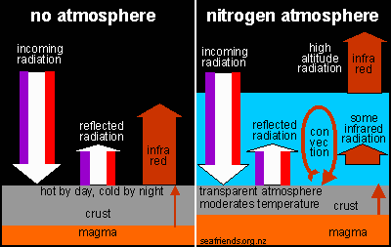

Slide 6
Composition of atmosphere
The principal gases comprising dry air in the lower atmosphere are:
Nitrogen (78.08 %)
Oxygen (20.94%)
Argon (0.93 %)
Carbon dioxide (0.03%)
Neon (0.0018%)
Helium (0.00005%)
Ozone (0.00006%)
Hydrogen (0.00005%)
Krypton (trace)/ Xenon (Trace)/ Methane (Trace)
Water vapor and dust particle

Slide 7
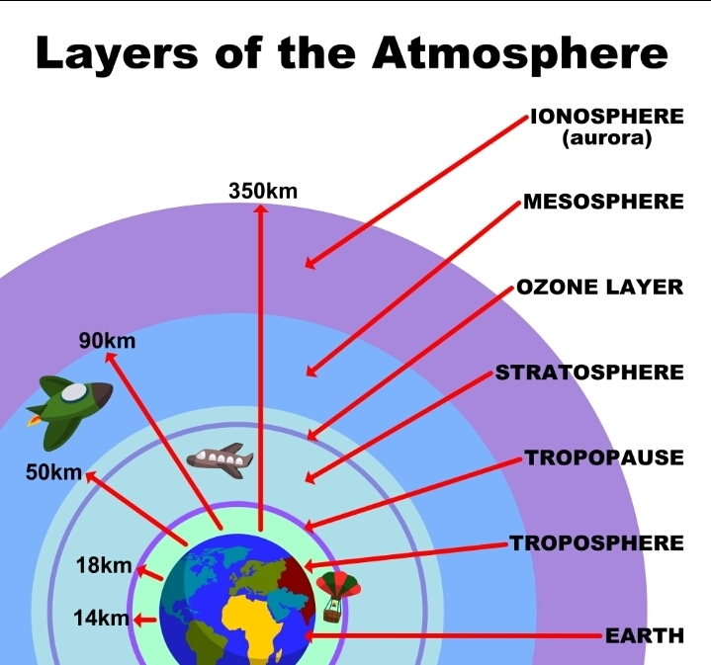
Structure of atmosphere

Slide 8
Structure of atmosphere
Earth’s atmosphere extends up to 1600 km from the earth surface. 97 percent of the total amount of weight of the atmosphere is limited upto the height of about 30 kilometers.
The atmosphere can be divided into five layers according to the diversity of temperature and density.
Troposphere
Stratosphere
Mesosphere
Ionosphere
Exosphere

Slide 9
Troposphere
This is the lowest layer of the atmosphere.
The height of this layer is about 18 kms on the equator and 8 kms on the poles. The main reason of higher height at the equator is due to presence of hot convection currents that push the gases upward.
This is the most important layer of the atmosphere because all kinds of weather changes take place only in this layer. Due to these changes development of living world take place on the earth. The air never remains static in this layer. Therefore this layer is called changing sphere or troposphere.
The environmental temperature decreases with increasing height of atmosphere. It decreases at the rate of 10C at the height of 165 metre. This is called Normal lapse rate.
The upper limit of the troposphere is called tropopause. This is a transitional zone. In this zone characteristics of both the troposphere and ionosphere are found.

Slide 10
STRATOSPHERE
(i)This layer is above the troposphere.
(ii) This layer is spread upto the height of 50 kms from the Earth’s surface. Its average extent 40 kms.
(iii) The temperature remains almost the same in the lower part of this layer upto the height of 20 kms. After this the temperature increases slowly with the increase in the height. The temperature increases due to the presence of ozone gas in the upper part of this layer.
(iv) Weather related incidents do not take place in this layer. The air blows horizontally here. Therefore this layer is considered ideal for flying of aircrafts.

Slide 11
Mesosphere
It is the third layer of the atmosphere spreading over stratosphere.
It spreads upto the height of 80 kms. from the surface of the earth. It’s extent is 30 kms.
Temperature goes on decreasing and drops upto – 1000C.
‘Meteors’ or falling stars occur in this layer.

Slide 12
Ionosphere
This is the fourth layer of the atmosphere. It is located above the mesosphere.
This layer spreads upto the height of 400 kms. from the surface of the earth. The width of this layer is about 300 kms.
The temperature starts increasing again with increasing height in this layer.
Electrically charged currents flows in the air in this sphere. Radio waves are reflected back on the earth from this sphere and due to this radio broadcasting has become possible

Slide 13
Exosphere
This is the last layer of the atmosphere located above ionosphere and extends to beyond 400 km above the earth.
Gases are very sparse in this sphere due to the lack of gravitational force. Therefore, the density of air is very less here.
Density of air is the least in the exosphere.

